Slide 2
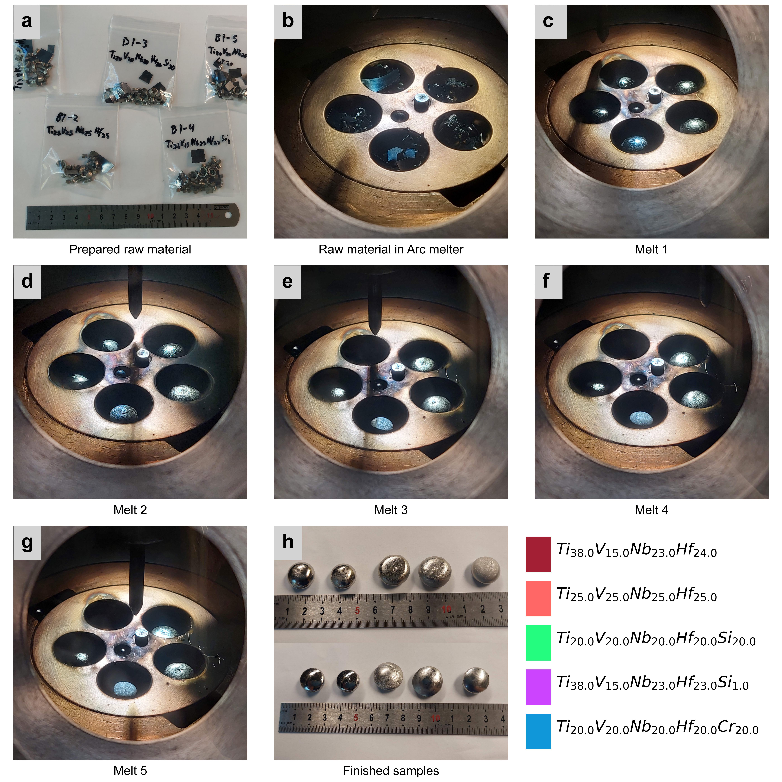
Facing Arc
Facing Crucible

